Slide 1
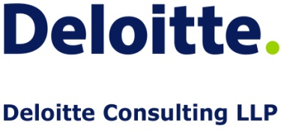
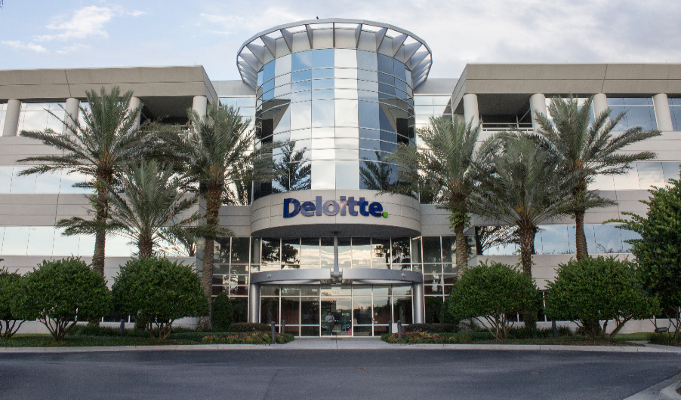
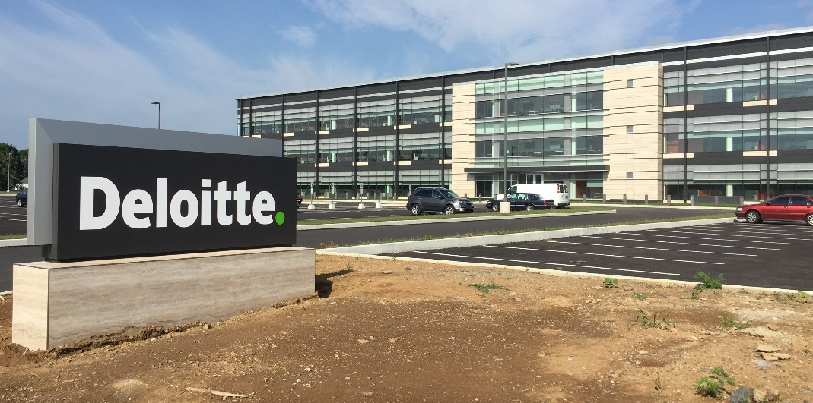
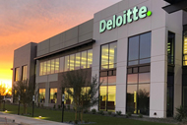
USDC Information Technology Center of Excellence (IT-CoE)
Topic: CompTIA Security+ Testing Review
Orlando, FL
Mechanicsburg, PA
Gilbert, AZ

Slide 2
Physical and Cloud Security
Security+
Session 8
CompTIA Security+
Test: SYO-601
EXAM OBJECTIVES (DOMAINS)
The table below lists the domains measured by this examination and the extent to which they are represented:
Session 8
Includes Objectives from Domains 2, 3, and 5
Objective 2.1 – Explain the importance of security concepts in an enterprise environment.
Objective 2.2 – Summarize virtualization and cloud computing concepts.
Objective 2.5 – Given a scenario, implement cybersecurity resilience.
Objective 2.7 – Explain the importance of physical security controls.
Objective 3.6 – Given a scenario, apply cybersecurity solutions to the cloud.
Objective 5.2 – Explain the importance of applicable regulations, standards, or frameworks that impact organizational security posture.
Domain | Weight
1.0 Threats, Attacks and Vulnerabilities | 24%
2.0 Architecture and Design | 21%
3.0 Implementation | 25%
4.0 Operations and Incident Response | 16%
5.0 Governance, Risk, and Compliance | 14%
Total | 100%

Slide 3
Physical and Cloud Security
Security+
Session 8
Terminology
Hypervisor – The software that allows virtual machines to exist. The machine running the hypervisor is known as a host, while the instances of virtual machines are known as guests.
Infrastructure as a Service (IaaS) – A model of cloud computing that utilizes virtualization; clients pay an outsourcer for the resources used.
Platform as a Service (Paas) – A cloud service model wherein the consumer can deploy but does not manage or control any of the underlying cloud infrastructure.
Software as a Service (SaaS) – A model of cloud computing in which the consumer can use the provider’s applications, but they do not manage or control any of the underlying cloud infrastructure.
Type I Hypervisor – Virtualization method that is independent of the operating system and boots before the operating system.
Type II Hypervisor – Virtualization method that is dependent on the operating system.

Slide 4
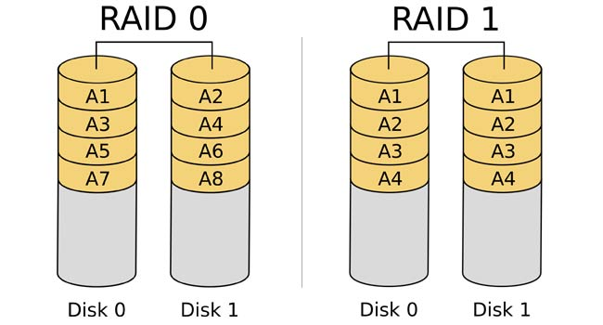
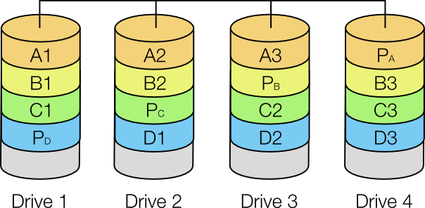
Physical and Cloud Security
Security+
Session 8
RAID – Redundant Array of Independent Disks
RAID Level 0 – Disk striping, uses multiple drives and maps them together as a single physical drive. No fault tolerance.
RAID Level 1 – Disk mirroring, everything is stored on two disks. Data is written to both disks at the same time. Complete redundancy and fault tolerance.
RAID Level 3 – Disk striping with a parity disk, striping in conjunction with a separate disk for parity. Provides fault tolerance.
RAID Level 5 – Disk striping with parity bit, striping with parity spread across all of the disks in the array. Requires at least 3 drives. Best for fault tolerance.
RAID 5

Slide 5
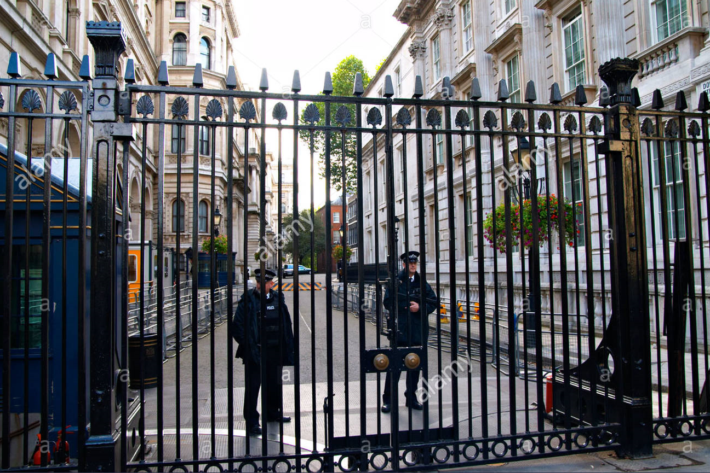
Physical and Cloud Security
Session 8
Security+
Understanding Physical Security
Fencing, Gates, and Cages
Perimeter security can be physical or technological, is the first line of defense for the facility and everything within the facility.
Perimeter security is accomplished through:
Fencing, gates, cages, locks, doors, surveillance systems and alarm systems.
Security Guards
Security guards can add to the security of the facility with guards patrolling the perimeter, and internally, patrolling the facility. Guards are an expensive addition to the physical security defense but are a definite visible deterrent.

Slide 6
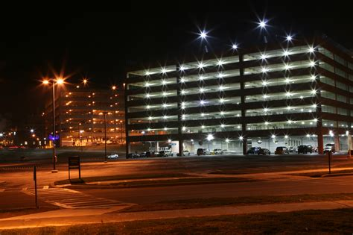
Physical and Cloud Security
Session 8
Security+
Understanding Physical Security
Lighting
Lighting, in and around the facility is important for security. In areas, inside and outside, that are not properly lighted are areas where attackers can hide and move around the facility to find a weak entrance point.
Signs
Signs identify areas around the facility, that are allowed and areas that are not allowed for non-employees and are illegal and will be open to trespassing charges.

Slide 7
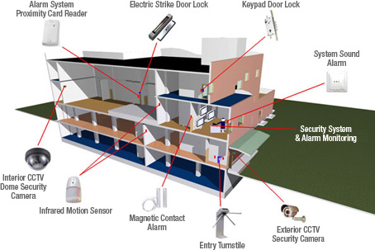
Physical and Cloud Security
Session 8
Security+
Understanding Physical Security
Alarms
Security alarm systems can alert security personnel to breaches in the perimeter security, and any other illegal access.
These can include motion sensors, or activated by breaches in doors or windows. Alarms can be targeted to security zones, where the facility is divided into zones for easy identification of breaches.

Slide 8
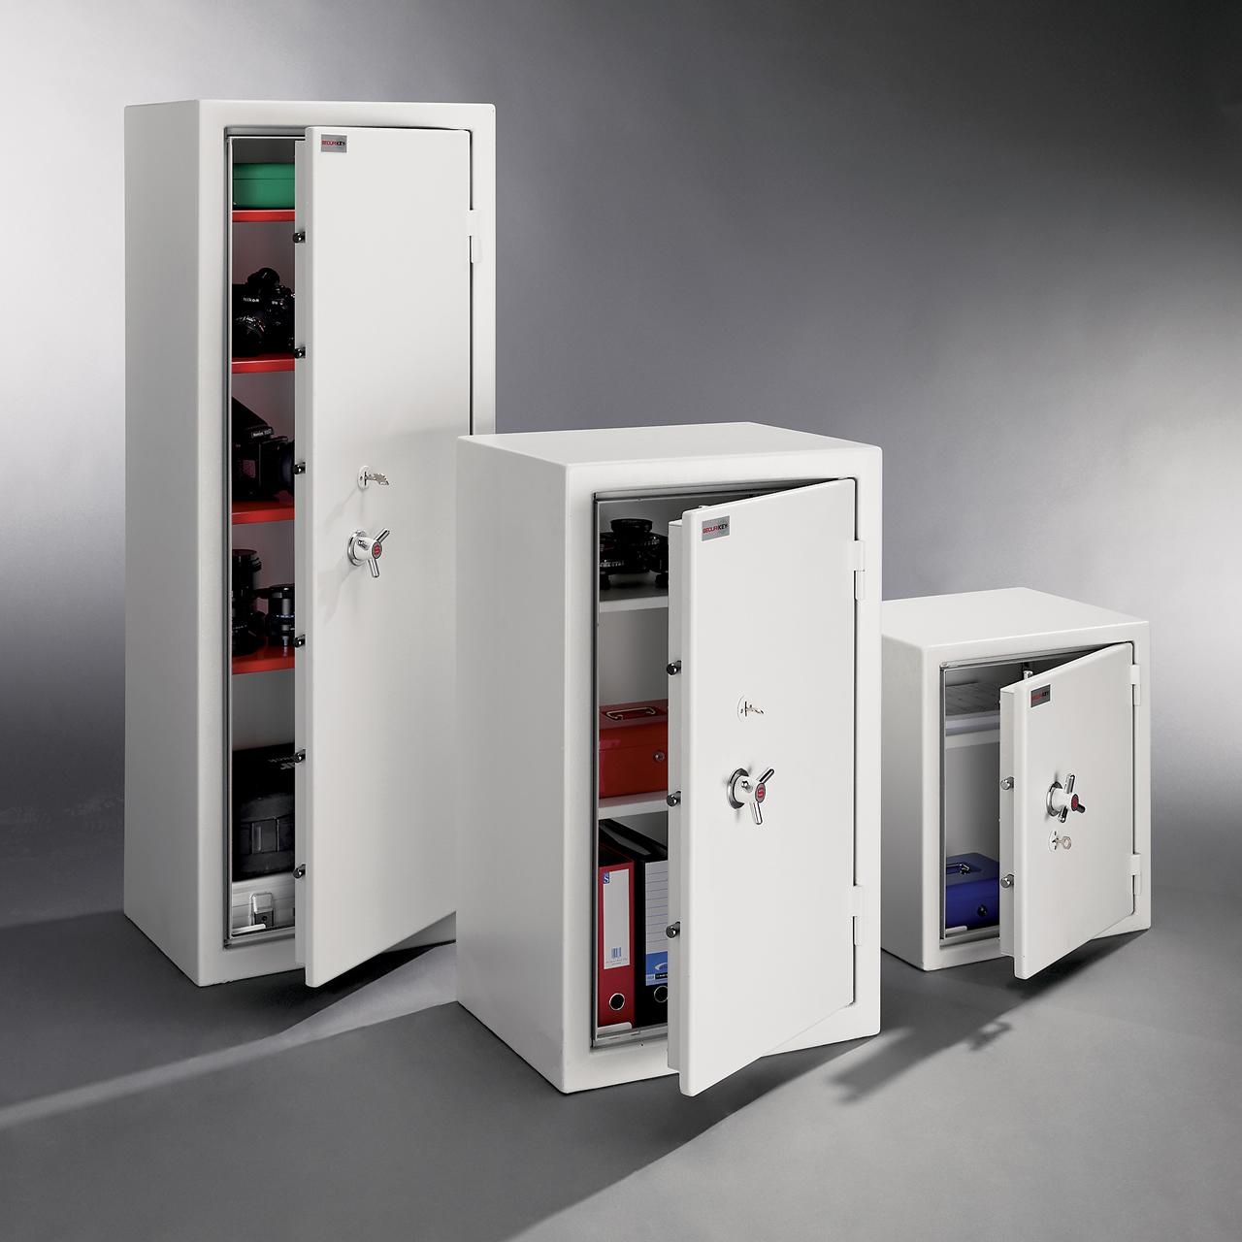
Physical and Cloud Security
Session 8
Security+
Understanding Physical Security
Safe
A safe provides a secure physical location for critical confidential items to be stored. This could be hard drives, backup tapes, hard copy reports, or any other media. Safes should be fireproof and study enough to withstand burglary, robbery, and internal theft.
Secure Cabinets
Protecting computer workstations and peripherals can be done with cables that connect with locks to secure the workstations desktop cabinets. Cables can also be routed to secure monitors and other peripherals from theft.

Slide 9
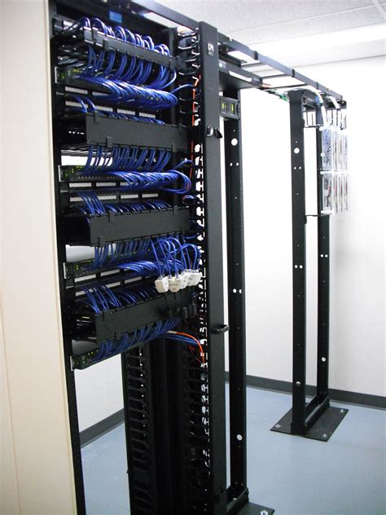
Physical and Cloud Security
Session 8
Security+
Understanding Physical Security
Protected Cabling
Physical security of network cabling is important to secure the network cabling from damage, disruption, and physical tampering.
Cabling is also susceptible to eavesdropping or ‘in-transit modification’.
Cable closets should be locked and secured.

Slide 10
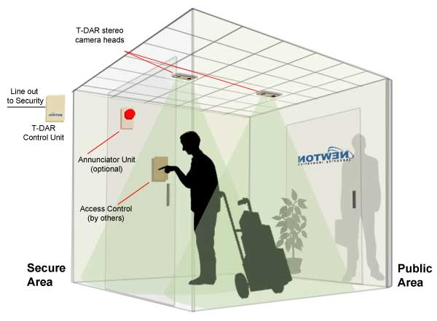
Physical and Cloud Security
Session 8
Security+
Understanding Physical Security
Mantrap
A high security mechanism that provides access to the facility via a device that allows only one person to access the facility at a time.
The mantrap can isolate one person at a time while their access permissions are validated, and if necessary, can trap the person in the device if access is denied or if they are discovered to be a threat to the facility.

Slide 11
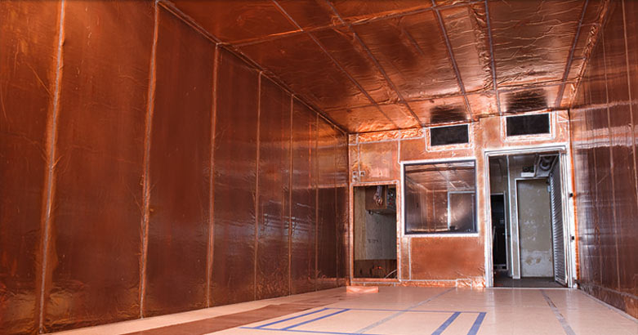
Physical and Cloud Security
Session 8
Security+
Understanding Physical Security
Faraday Cage
Shielding to prevent electronic emissions from computer systems from being captured to gather intelligence. This shielding also prevents outside electronic emissions from disrupting your network and computer systems.
This can be done with a computer data center, or a wider area. The shielding consists of electrically conductive wire mesh or other conductor woven into a ‘cage’ that surrounds the room.

Slide 12
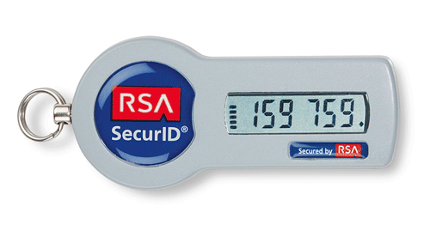
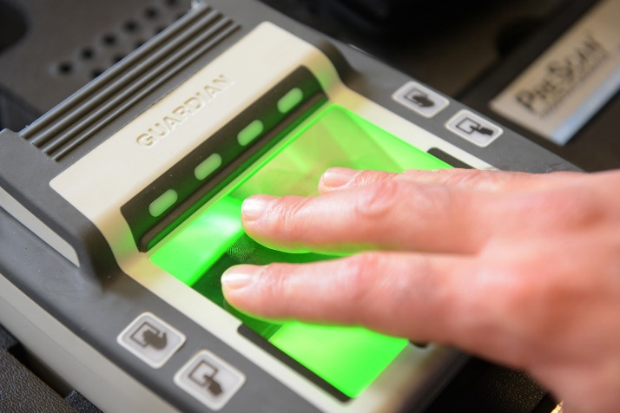
Physical and Cloud Security
Session 8
Security+
Understanding Physical Security
Biometrics
There are numerous biometric devices that add to the security of access to your facility, either building access or individual room access. These include fingerprint scanners, retinal scanners, facial recognition applications, and keystroke recognition program. Many laptops and cell phones now have fingerprint readers to provide access. These technologies have improved over the years to make them more secure.
Tokens/Cards
Physical tokens or FOBs are devices that generate one-time, time sensitive access passwords to authenticate identity.
SecureID from RSA is one of the best-known physical tokens.

Slide 13
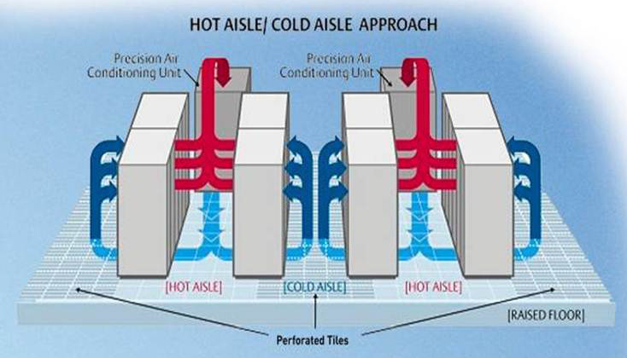
Physical and Cloud Security
Session 8
Security+
Understanding Physical Security
HVAC
Computer rooms require high-intensity cooling and venting, that is required to be on continuously. The ideal location for a computer room is in the center of a building with isolated HVAC cooling in its own HVAC zone.
Hot and Cold Aisles
Server rooms are arranged in rows of servers in racks. The rows of servers are known as aisles. The HVAC cooling system is arranged as hot aisles and cold aisles. This provides constant circulation for the server racks.

Slide 14
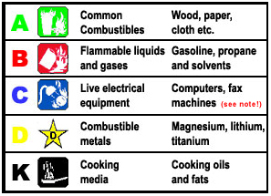
Physical and Cloud Security
Session 8
Security+
Understanding Physical Security
Fire Suppression
Fire extinguishers are portable systems that control and extinguish fires. Portable fire extinguishers should be available in all computer rooms and throughout the facility. These should be of a Class C type for electrical fires.
Modern buildings are required to have a modern fire-suppression system in the form of a sprinkler system that is connected to the building water system or to an isolated water reservoir.
Water based sprinkler systems cause extensive damage to electronic equipment. Different mediums are available for fire-suppression, such as gas-based systems.

Slide 15
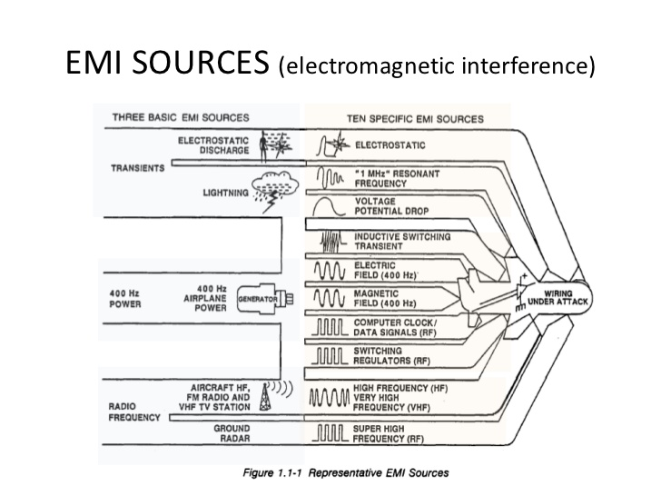
Physical and Cloud Security
Session 8
Security+
Understanding Physical Security
EMI Shielding
Electromagnetic interference (EMI) is generated by motors, florescent lights, and other electromechanical devices. EMI can cause circuit overloads, spikes in electrical power, or failure of other electrical components. Much of EMI can be prevented by properly shielding and grounding electromechanical devices.
Radio frequency interference (RFI) is similar to EMI but is projected as radio frequency interference through the radio spectrum. This can cause problems with wireless access points. This process is called desensitizing.

Slide 16
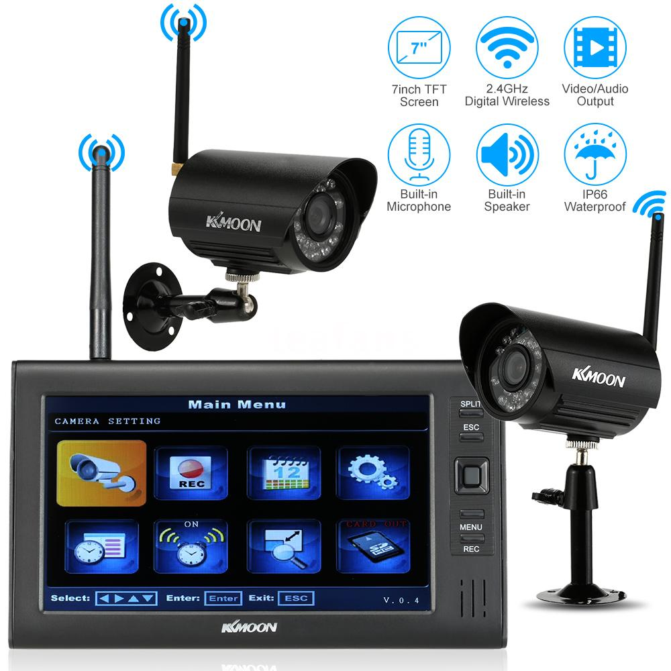
Physical and Cloud Security
Session 8
Security+
Understanding Physical Security
Cameras
Camera can be placed as a security feature on the outside of the building as well as inside the building to track and identify activity near and in the building. Cameras record all activity that is visible to them and provide a means to review historical activity.
Motion Detectors
Cameras can include motion detectors to begin recording when any motion is detected. Motion detectors can also act as defense mechanisms to activate alarms when motion is detected. Sensors can be infrared, microwave, or sound and can use a hybrid of these sensors as well.

Slide 17
Physical and Cloud Security
Session 8
Security+
Data Security and Privacy Practices
Data Destruction and Media Sanitation
Methods of securely destroying paper reports, data, and media when no longer needed.
Burning – Controlled incineration or burning is used to destroy hard copies of data and some media.
Shredding – Shredding of paper reduces the paper to unreadable form. Shredding can be used with CD’s and DVD’s. Some shredders are strip shedders, but cross-cut shredders cut in more that one direction.
Pulping – Pulping reduces paper to a liquid slurry which can be used in post-consumer products.
Pulverizing – Documents are fed into a pulverizer that reduces the documents to loose fibers and shards. There are also pulverizers for hard disk drives.

Slide 18
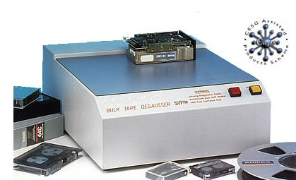
Physical and Cloud Security
Session 8
Security+
Data Security and Privacy Practices
Degaussing
This process is used with magnetic media to destroy the data on the media.
The degausser is a large magnet that changes the magnetic fields on the media that holds the data.
Purging – Permanently removing data from a data media.
Wiping – Writing data over the positions where data was purged to replace the old data with new data that is just a pattern of zeros.

Slide 19
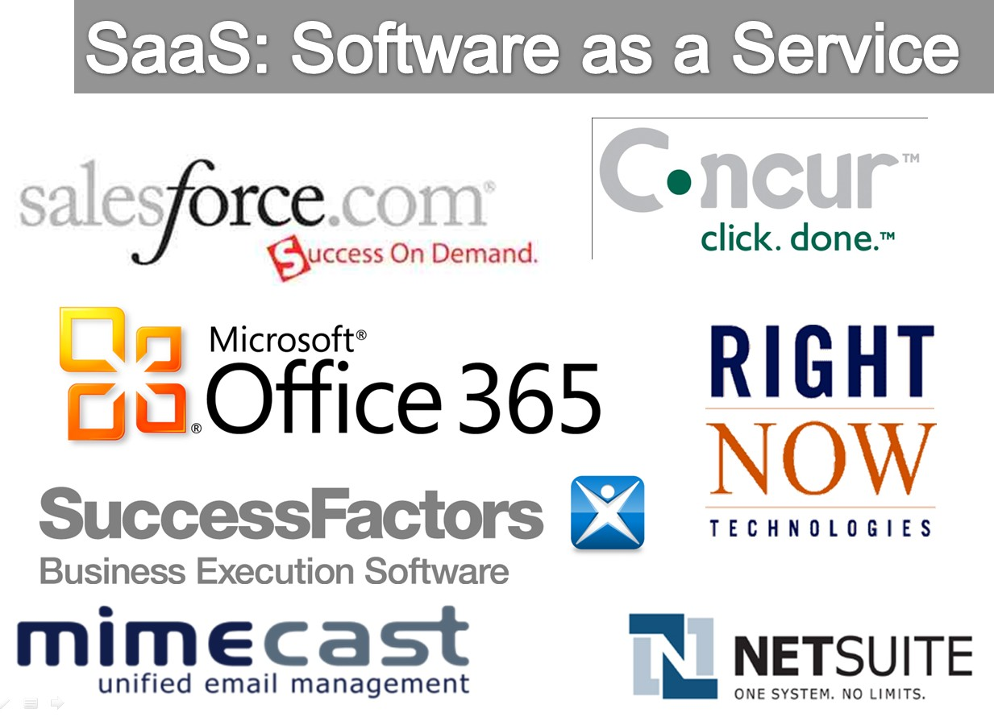
Physical and Cloud Security
Security+
Session 8
Working with Cloud Computing
Software-as-a-Service (SaaS)
The capability provided to the consumer to use the cloud provider’s applications running on a cloud infrastructure. The consumer does not manage or control the underlying cloud infrastructure including networks, servers, operating systems, storage or application capabilities, and with limited user-specific application configuration settings.
Common software available:
Office 365
SharePoint-Online
Salesforce

Slide 20
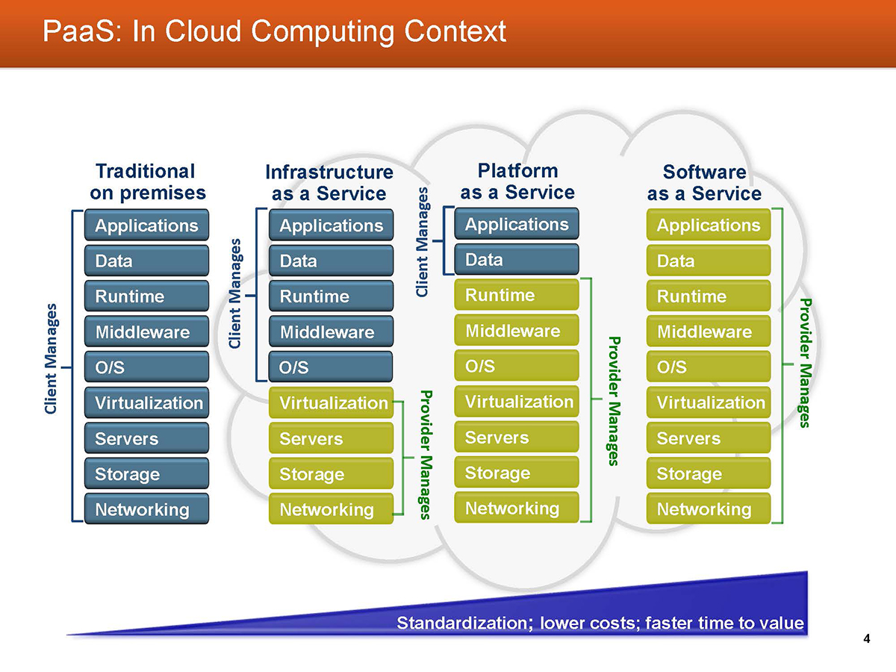
Physical and Cloud Security
Security+
Session 8
Working with Cloud Computing
Platform-as-a-Service (PaaS)
The capability for the consumer to deploy their own applications onto the cloud platform infrastructure, but with no management control over the cloud infrastructure. Including networks, servers, operating systems, or storage. The consumer has control over the deployed applications and possibly configuration settings for the application-hosting environment.

Slide 21
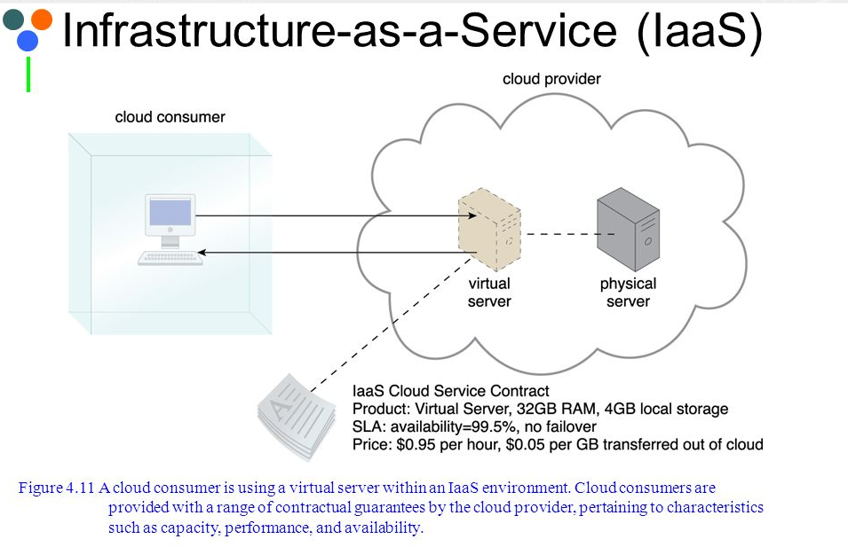
Physical and Cloud Security
Security+
Session 8
Working with Cloud Computing
Infrastructure-as-a-Service (IaaS)
A cloud solution where you are purchasing infrastructure, virtual machines and other resources as a service to subscribers. A host server hypervisor runs your virtual machines as guests.
You have complete management control over the virtual machines, the cloud provider manages the host hypervisor.

Slide 22
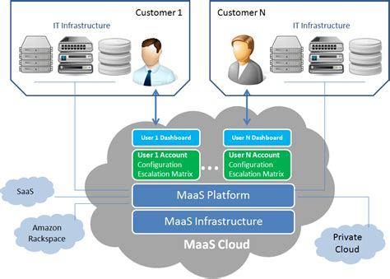
Physical and Cloud Security
Security+
Session 8
Working with Cloud Computing
Monitoring-as-a-Service (MaaS)
Monitoring of installed applications, systems, networks or other components against a set of metrics and standards.
For example: Overall timeout requests for an installed application can be monitored for acceptable values.

Slide 23
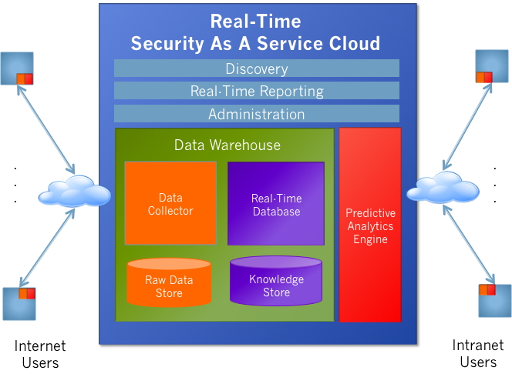
Physical and Cloud Security
Security+
Session 8
Working with Cloud Computing
Security-as-a-Service (SecaaS)
Security services are provided by the cloud solution. Anti-virus and other security software delivered over the internet to scan an on-premises network.
Professional security services provided to the local network.
Services include:
Authentication
Anti-virus
Anti-malware/spyware
Intrusion detection
Penetration testing ,
SIEM

Slide 24
Physical and Cloud Security
Security+
Session 8
Knowledge Check 1
A company is evaluating cloud providers to reduce the cost of its internal IT operations. The company's aging systems are unable to keep up with customer demand. Which of the following cloud models will the company
MOST likely select?
A. PaaS
B. SaaS
C. IaaS
D. BaaS

Slide 25
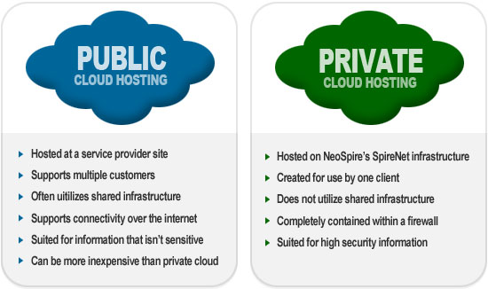
Physical and Cloud Security
Security+
Session 8
Working with Cloud Computing
Public Cloud
The standard cloud computing model. A service provider makes resources available to the public over the Internet. An organization can select services and resources and can add and remove resources based on their subscription. Major vendors of public clouds are Amazon, Google, IBM, and Microsoft.
Private Cloud
A cloud computing model where the organization implements a cloud environment within its internal enterprise/data center. The private cloud then is available for the organizations employees and partners.

Slide 26
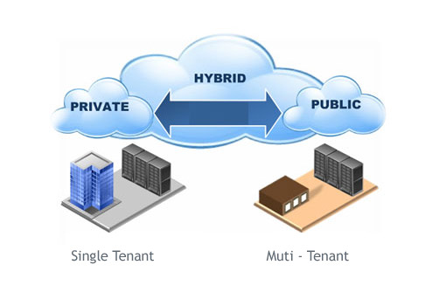
Physical and Cloud Security
Security+
Session 8
Working with Cloud Computing
Hybrid Cloud
A cloud computing model where the organization provides some IT resources in-house, and others are provided externally via a public cloud. Confidential and private information are kept in the private cloud, and the remainder can be hosted in the public cloud.

Slide 27
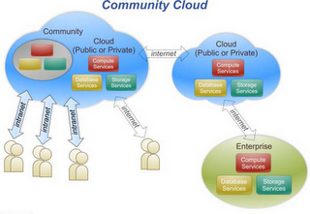
Physical and Cloud Security
Security+
Session 8
Working with Cloud Computing
Community Cloud
A cloud computing model where the cloud infrastructure is shared among several organizations in a specific group with common computing needs. In this model Security Agreements define that security controls that are in place to protect each members data, and how the cloud infrastructure will be administered and managed.

Slide 28
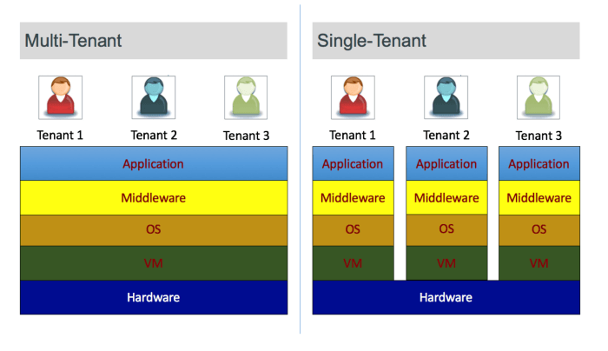
Physical and Cloud Security
Security+
Session 8
Working with Cloud Computing
Multi-Tenancy Model
A cloud computing model where the multiple organizations share cloud resources. This model is less expensive and gives administrative control to the cloud service provided to manage the shared resources.
Single-Tenancy Model
A cloud computing model where a single organization uses a specific resource, like a server host. This model ensures that the tenant organization’s data is protected from other organizations.

Slide 29
Physical and Cloud Security
Security+
Session 8
Knowledge Check 2
Which of the following types of cloud infrastructures would allow several organizations with similar structures and interests to realize the benefits of shared storage and resources?
A. Private
B. Hybrid
C. Public
D. Community

Slide 30
Physical and Cloud Security
Security+
Session 8
Working with Cloud Computing
Cloud Providers
Amazon Web Services
Microsoft Azure
Google
iCloud
Citrix
Rackspace
Salesforce
Sun
VMWare
Types of Cloud Structures
Public Cloud
Private Cloud
Hybrid Cloud
Community Clouds
Multitenancy
Single Tenancy
Benefits of Cloud Computing
Reduces Cost
Increases Storage
High Degree of Automation
Offers Flexibility
Provides More Mobility
Allows Company IT Department to focus on other Priorities

Slide 31
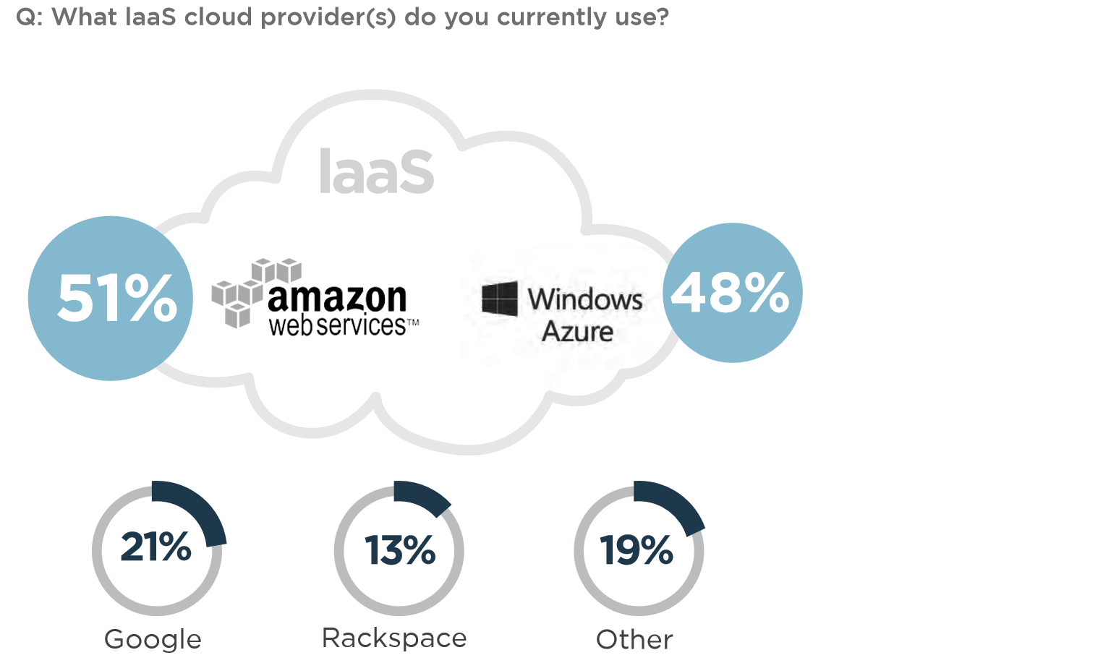
Physical and Cloud Security
Security+
Session 8
Working with Cloud Computing
Amazon Web Services and Windows Azure – Cloud Leaders

Slide 32
Physical and Cloud Security
Security+
Session 8
Working with Cloud Computing
Checklist for Cloud Provider
Does the cloud provider use a data classification system?
What training does the cloud provider offer its employees?
What are the service level agreement (SLA) terms?
Is there a right to audit?
Does the cloud provider have a long-term viability?
How will the cloud provider respond if there is a security breach?
What is the disaster recovery and business continuity plan (DR/BCP)?

Slide 33
Physical and Cloud Security
Security+
Session 8
Working with Cloud Computing
Cloud Computing Vulnerabilities
Authentication Attacks
Denial of Service (DoS)
Man-in-the-Middle Attacks
Data Aggregation and Data Isolation
Data Remnants
Keylogging
Custom Malware
Cloud Augmented Security Services
Antispam
Antivirus
Content Filtering
Hash Matching
Sandboxing
Vulnerability Scanning

Slide 34
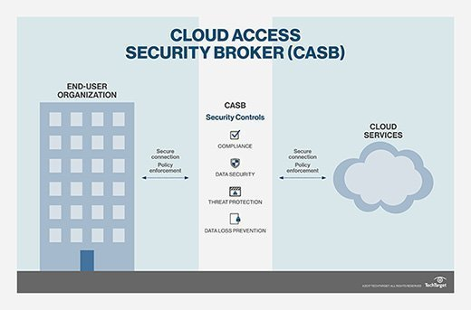
Physical and Cloud Security
Security+
Session 8
Working with Cloud Computing
Cloud Access Security Broker (CASB)
Allows the user to extend their security policies into their cloud environment. Policies such as:
Credential Mapping
Single Sign-on
Encryption
Data Loss Prevention
Compliance

Slide 35
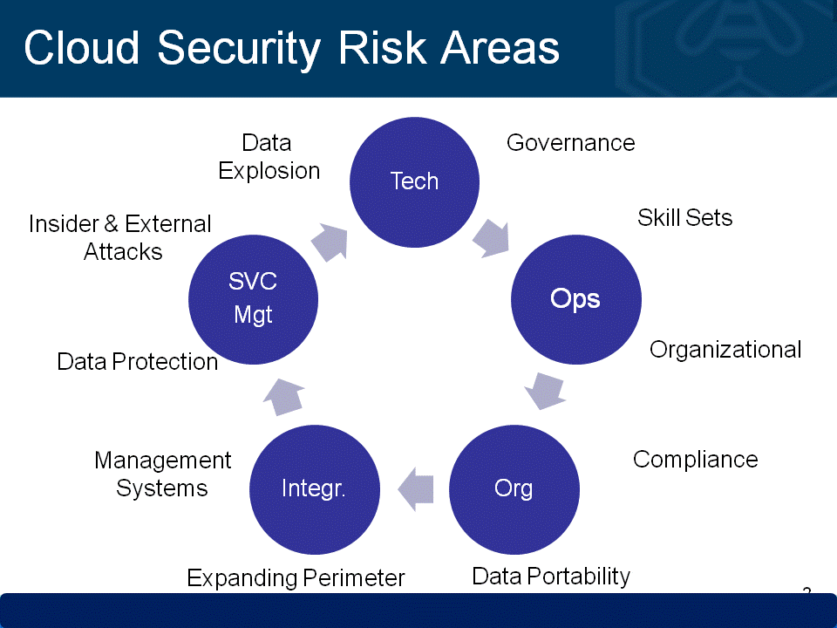
Physical and Cloud Security
Security+
Session 8
Working with Cloud Computing
Cloud Computing Concerns
Data Privacy
Confidentiality
Legal and Regulatory Compliance
Data Sovereignty/Control
Auditing and Reporting Requirements

Slide 36
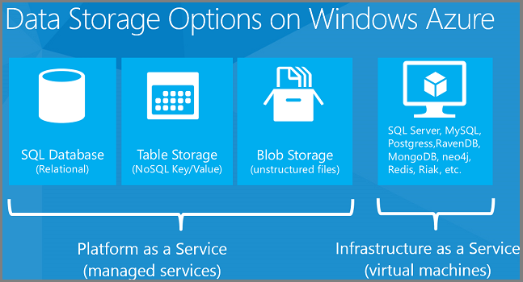
Physical and Cloud Security
Security+
Session 8
Working with Cloud Computing
Cloud Storage Options
Cloud providers offer multiple options for data storage, that can be used for data warehousing, data lake storage for AI, SQL server storage, and storage for offsite backups of local files.

Slide 37
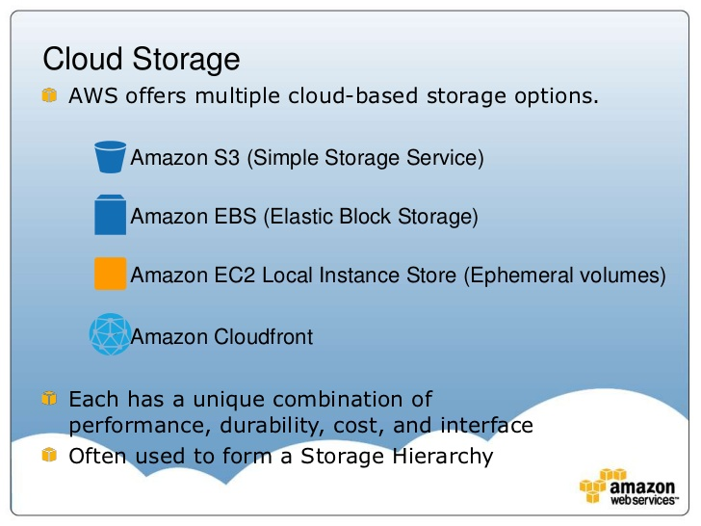
Physical and Cloud Security
Security+
Session 8
Working with Cloud Computing
Cloud Storage Options (AWS)
Cloud providers offer multiple options for data storage, that can be used for data warehousing, data lake storage for AI, SQL server storage, and storage for offsite backups of local files.

Slide 38
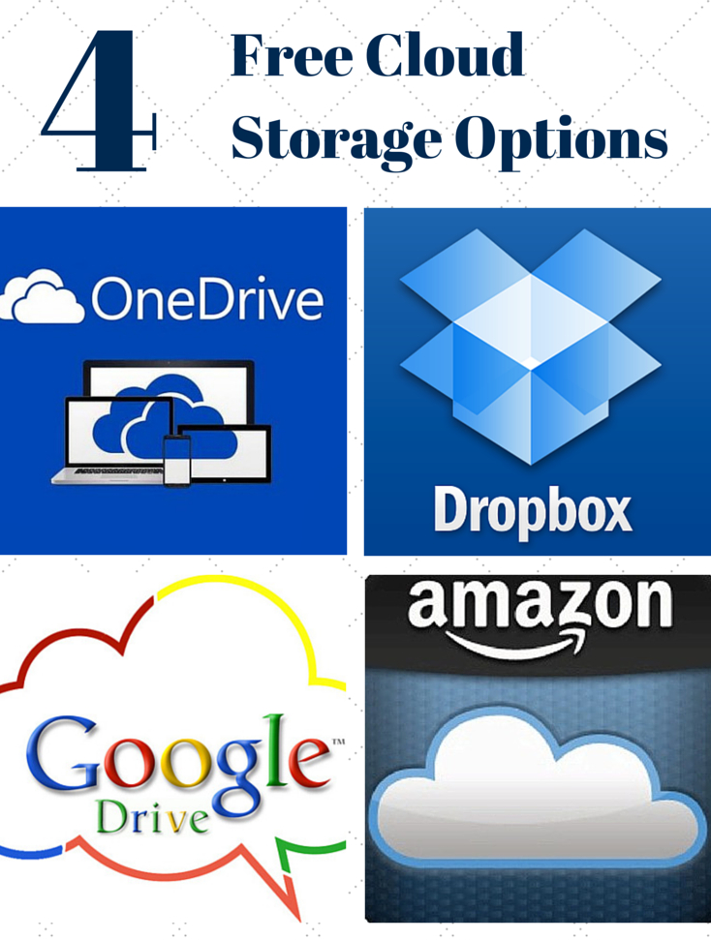
Physical and Cloud Security
Security+
Session 8
Working with Cloud Computing
Free Cloud Storage
There are multiple free cloud storage options to store and keep personal files.
These storage options are NOT secure, even for files in-transit. Should only be used for files that you would consider being released to the public.

Slide 39
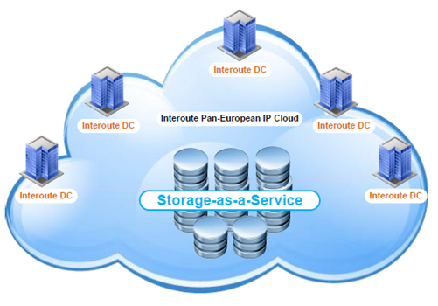
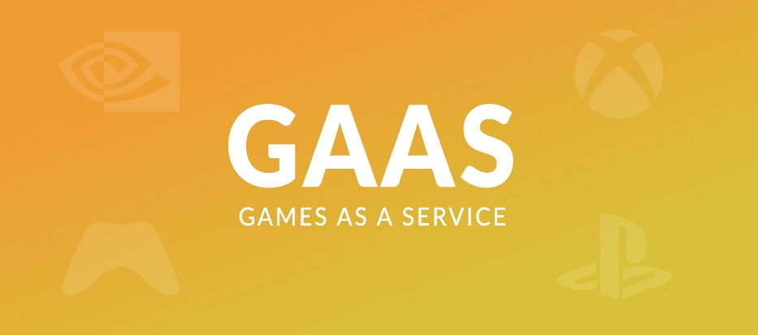
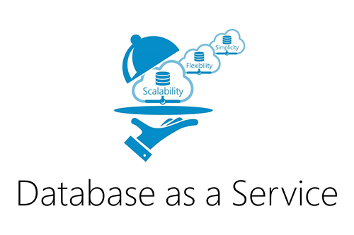
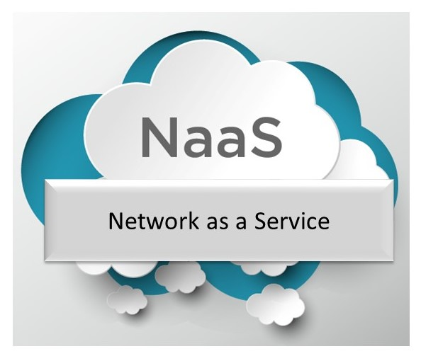
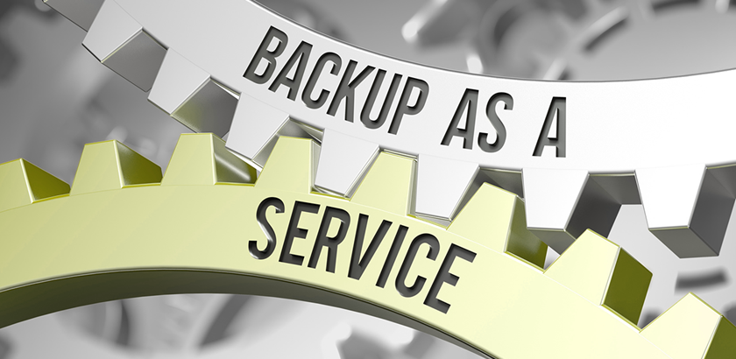
Physical and Cloud Security
Security+
Session 8
Working with Cloud Computing
Other Cloud Services

Slide 40
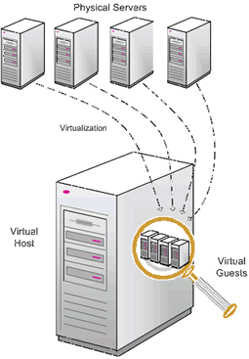
Physical and Cloud Security
Security+
Session 8
Working with Virtualization
Virtual Machine Types
Application Virtual Machines
Mainframe Virtual Machines
Parallel Virtual Machines
Operating System Virtual Machines
Operating System Virtual Machines
VMWare (ESXHost)
Sun VirtualBox
HyperV (Microsoft)
XENServer (Citrix)
Oracle VirtualBox

Slide 41
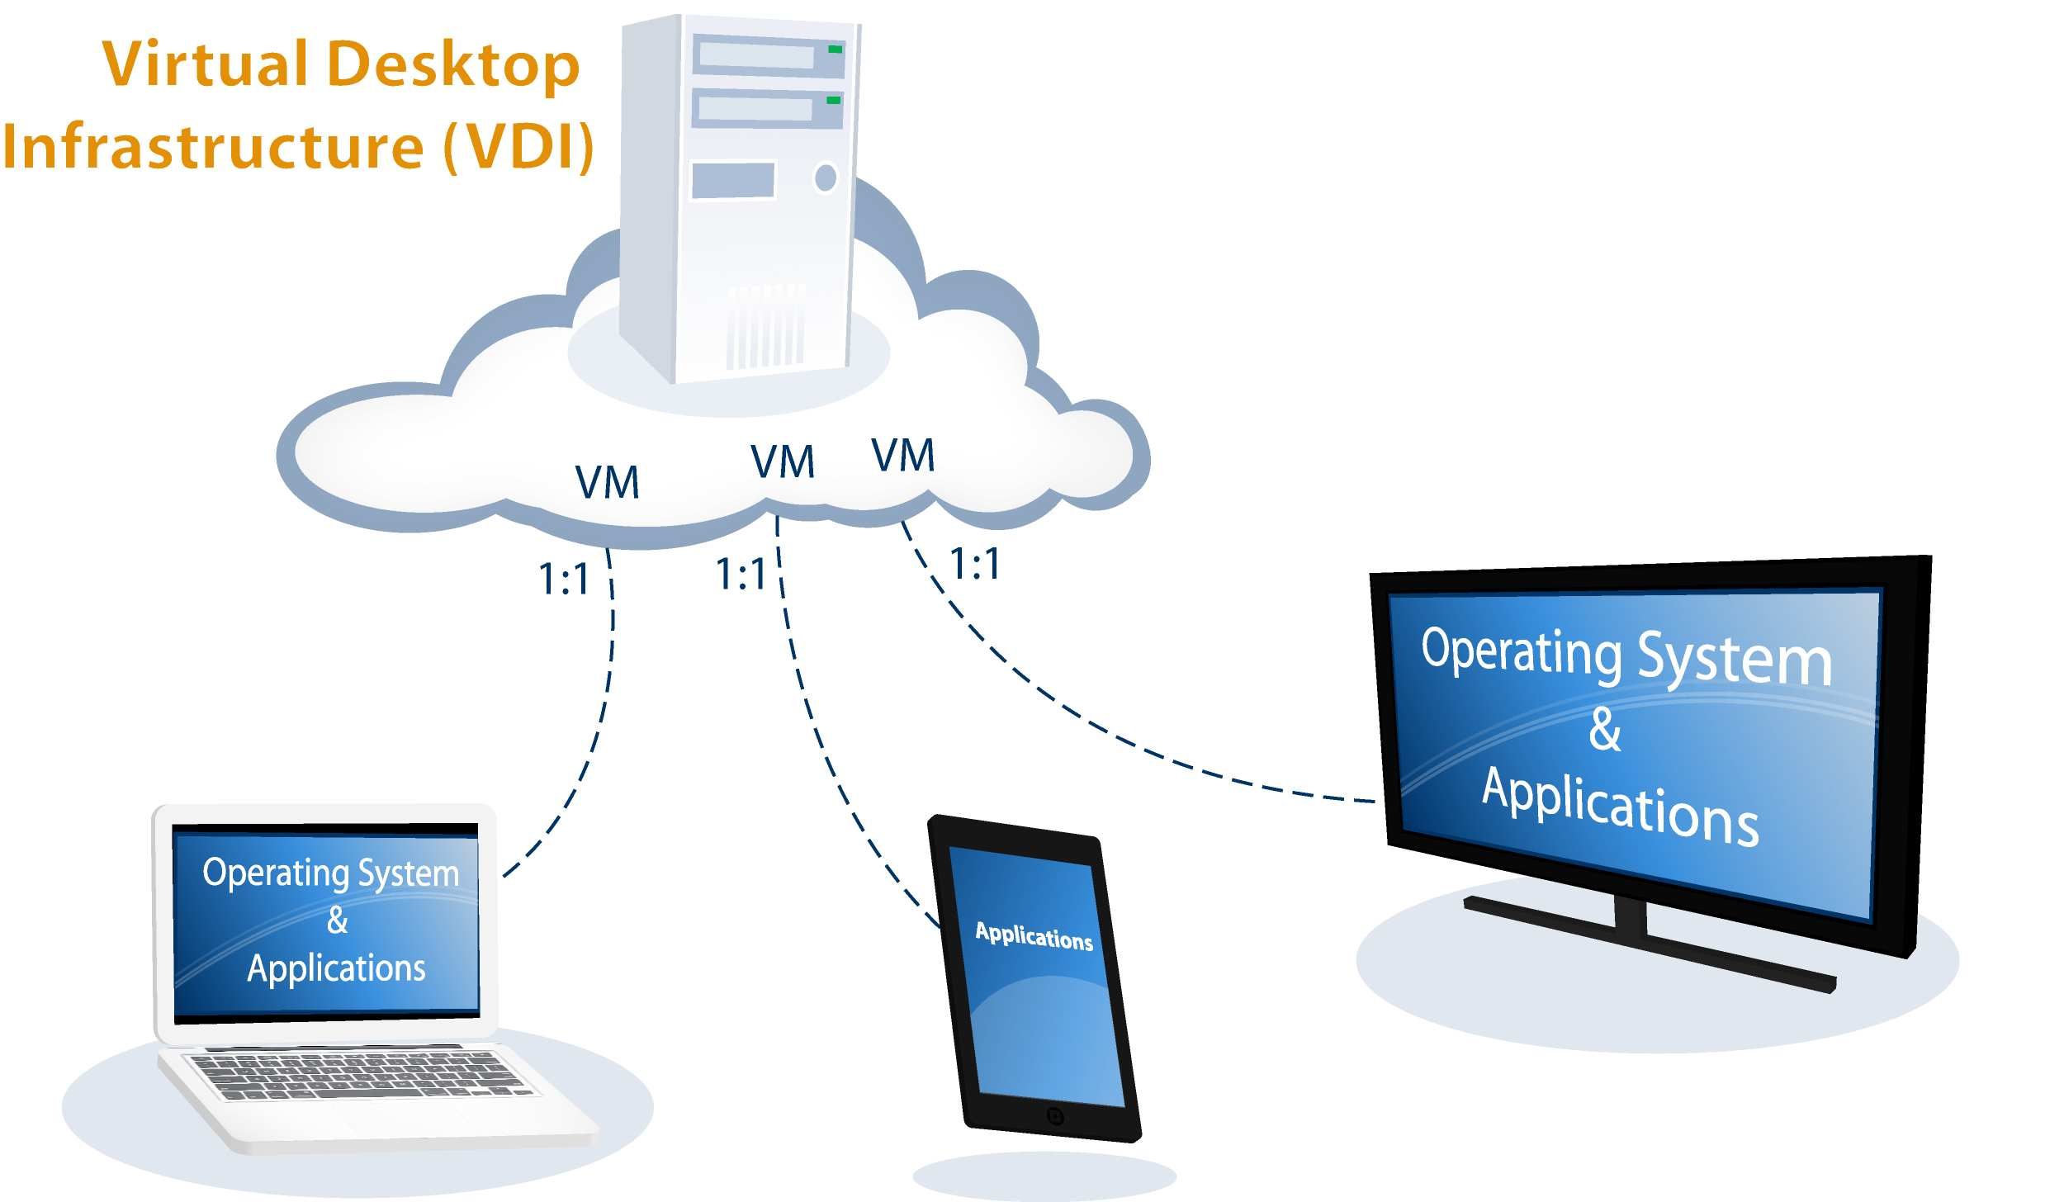
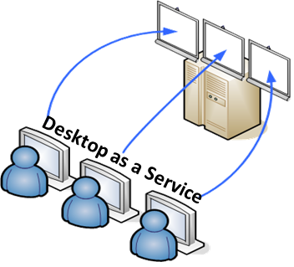
Physical and Cloud Security
Security+
Session 8
Working with Virtualization
Virtual Desktop Infrastructure (VDI)
Allows hosts to create guest operating system environments delivered through RDP.
Applications are run on the hypervisor host that supports the guest desktop operating systems.
This service can also be provided through a cloud service offering called:
Desktop-as-a-Service (DaaS).

Slide 42
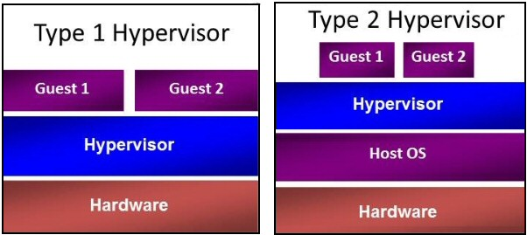
Physical and Cloud Security
Security+
Session 8
Working with Virtualization
Type 1 and Type 2 Hypervisors
Type 1 Hypervisors run directly on the hardware, while Type 2 Hypervisors run on top of an underlying host operating system.
Type 1 is called a bare metal hypervisor.

Slide 43
Physical and Cloud Security
Security+
Session 8
Working with Virtualization
Security Disadvantages of Virtualized Servers
Misconfigured Platforms – Virtualization requires additional administrator skills.
Live VM Migration – During migration, an attacker could attempt a man-in-the-middle attack and sniff the data as it moves over the network.
Data Remanence – Residual data from previous VMs provisioned and de-provisioned.
Single Point of Failure
Physical Access
Separation of Duties
Privilege Elevation
Attacks on Virtualized Servers
ScoobyDoo Attack
Red Pill Attack
These check the server Local Descriptor Table (LDT) to detect a virtual emulator like VMWare.

Slide 44
Physical and Cloud Security
Security+
Session 8
Knowledge Check 3
What type of hypervisor runs directly on top of a bare-metal servers’ hardware? A. Container B. Type 1 C. Type 2 D. Type 3

Slide 45
Wireless Network Threats
Security+
Session 5
Practice Test Question 1
An analyst receives an alert from the SIEM showing an IP address that does not belong to the assigned network can be seen sending packets to the wrong gateway.
Which of the following network devices is misconfigured and which of the following should be done to remediate the issue?
A. Firewall; implement an ACL on the interface
B. Router; place the correct subnet on the interface
C. Switch; modify the access port to trunk port
D. Proxy; add the correct transparent interface

Slide 46
Wireless Network Threats
Security+
Session 5
Practice Test Question 2
An organization is expanding its network team. Currently, it has local accounts on all network devices, but with growth, it wants to move to centrally managed authentication. Which of the following are the BEST solutions for the organization? (Select TWO)
A. TACACS+
B. CHAP
C. LDAP
D. RADIUS
E. MSCHAPv2

Slide 47
Wireless Network Threats
Security+
Session 5
Practice Test Question 3
Which of the following are the MAIN reasons why a systems administrator would install security patches in a staging environment before the patches are applied to the production server?
(Select two.)
A. To prevent server availability issues
B. To verify the appropriate patch is being installed
C. To generate a new baseline hash after patching
D. To allow users to test functionality
E. To ensure users are trained on new functionality

Slide 48
Wireless Network Threats
Security+
Session 5
Practice Test Question 4
A Chief Information Officer (CIO) drafts an agreement between the organization and its employees. The agreement outlines ramifications for releasing information without consent and/or approvals. Which of the following BEST describes this type of agreement?
A. ISA
B. NDA
C. MOU
D. SLA

Slide 49
Wireless Network Threats
Security+
Session 5
Practice Test Question 5
A manager suspects that an IT employee with elevated database access may be knowingly modifying financial transactions for the benefit of a competitor.
Which of the following practices should the manager implement to validate the concern?
A. Separation of duties
B. Mandatory vacations
C. Background checks
D. Security awareness training

Slide 50
Physical and Cloud Security
Security+
Session 8
Thank You!!
Send questions and slide deck requests to:
Jim Reeves
Security+, CASP+,CySA+, CISSP, ITILv3, CTT+
MCSE, MCSD, MCT
jireeves@Deloitte.com

